Slide 1
Dynamic RAD –
Airline Briefing for dynamic RAD DCT options within ENAIRE Airspace starting 4th Nov 2022

Slide 2
Introduction
Starting 4th Nov 2022 - UFN ENAIRE are trialling the use of Dynamic RAD which will make available the planning of already published DCT options for longer periods and therefore further optimising use of the airspace and reducing distance and fuel for the airlines that can make use of this.
Objectives
Allow ANSPs to test new dynamic restrictions.
- Stress the use of UUP.
- Support fine-tuning of the procedures as required.
- Facilitate the local assessment of the selected RADs.
- Allow AOs to take benefits from the proposed relaxation of dynamic RAD.
Trials
The trials will involve in sequence several ANSPs (DSNA, ENAIRE, ENAV, NATS, AVINOR). Each of them will define a specific live trial period. So far, the plan is to have DSNA in December with one restriction (level capping). The others will plan in 2023.

Slide 3
ENAIRE
For this new set of trials, the AUP will be used by ENAIRE to provide DCT availability for the morning period of D-OPS, the UUP at 9:30 UTC on D-OPS (UUP09:30) will be used by ENAIRE if necessary, to allocate some TZ (triggering zones) for that day mainly for the evening / night-time. In this particular case (DCT), the additional availability provided at D-OPS will allow flight plans through shorter routes.
Notification to the Airspace Users
To inform AUs of the starting of live trials, an AIM is published on the NOP Portal. The AIM covers the entire period of the trials, complementing the detail information available on the RAD home page under Additional Documentation/Dynamic RAD.
CFSPs should calculate these options when available in the initial plan but may also be of benefit if they can monitor availability and plan these when possible as would help with further usage. GRRT opportunities will be offered to eligible flights and NM FE Task Force will also monitor and advise of options plannable.
AUUP/UUP publication
The AUP/UUP will be the technical mean to able / disable a RAD restriction.
The DCTs will be made available for longer periods as published in the AUP/UUP and when the relevant triggering zone is published this makes the associated DCT available for times published.

Slide 4
AUP/EAUP-UUP/EUUP release example
FUA RAD restriction activated
Timely dependent applicability only
Sector LFRRNU not available for…..
RSA | CAT | MNM FL | MAX FL | WEF | UNT | FUA RAD restriction | FIR | UIR
LFTZ2107 | AMA | 000 | 005 | 06:00 | 09:00 | LFTZ2107X
LETZ321 | AMA | 000 | 005 | 14:00 | 20:00 | LETZ321B
LETZ321 | AMA | 000 | 005 | 20:00 | 23:00 | LETZ321B
AUP
UUP
DCT PONEN - LUMAS available for…..
FUA RAD restriction activated

Slide 5
The list of available DCTs
for this trial with relevant
Triggering Zones.

Slide 6
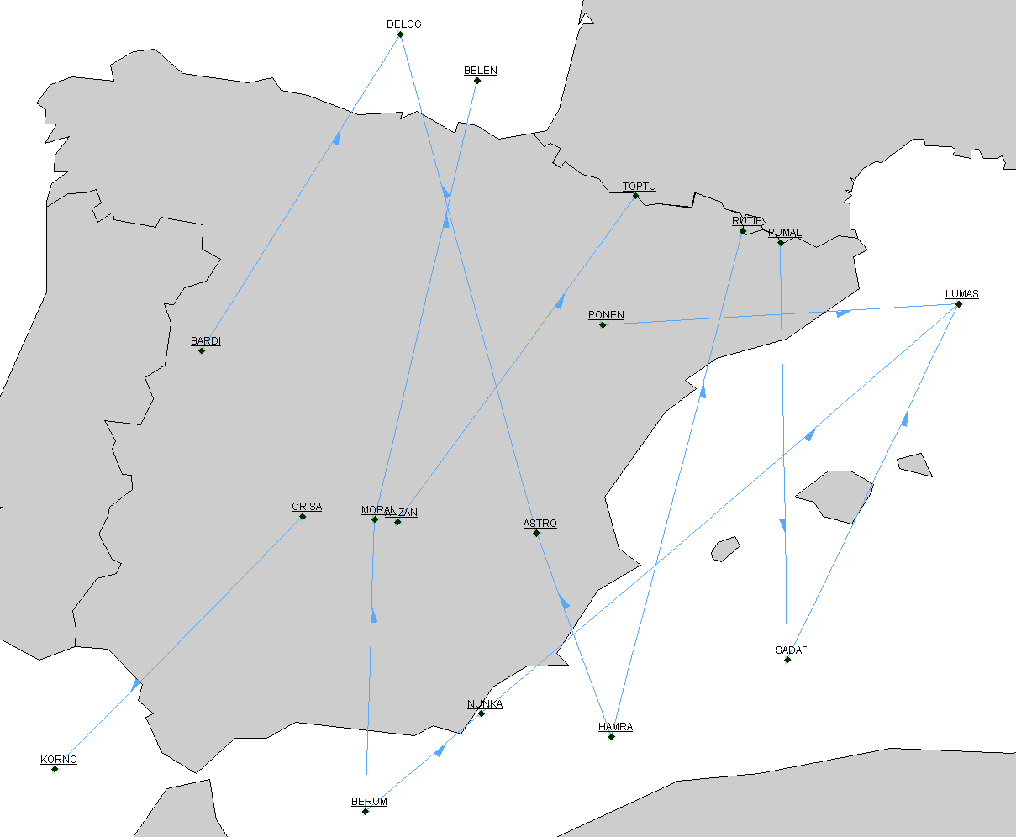
RAD - BLACK
DYNAMIC RAD - RED
TRIGGERING ZONE - GREEN
DRAD (ENAIRE)
LE2271 LE2149
LETZ2149B
LETZ2149
LE2090 LE3192
LETZ2090B
LETZ2090
LE2271 LE2122
LETZ2122C
LETZ2122
LE2761 LE3021
LETZ3021B
LETZ3021
List of RAD rules and Triggering zones per Dynamic RAD
LE2181 LE2842
LETZ2842B
LETZ2842
LE3034 LE3106
LETZ3034B
LETZ3034
LE2647 LE3102
LETZ2647B
LETZ2647X
LE2647 LE2121
LETZ2647C
LETZ2647Y
LE2761, LE2906
LETZ2906B
LETZ2906
LE2761 LE3107
LETZ3107B
LETZ3107
LE2268 LE2701
LETZ2268B
LETZ2268
LE2188 LE2841 LETZ2188BY
LETZ2188Y
LE2188 LE2907
LETZ2188BX
LETZ2188X

Slide 7
RAD - BLACK
DYNAMIC RAD - RED
TRIGGERING ZONE - GREEN
DRAD (ENAIRE)
Flights from GC LPFR_EGCC
LPFR_EGGD
LPFR_EGGW
LPFR_EGKK
LPFR_EGSS
LEMG_EDDF
LEMG_EFHK
LEMG_LKPR
LEMG_LSGG
LEMG_LSZH
LEAL_EGGD
LEAL_EGNM
LEAL_EGNT
LEAL_EGPF
LEAL_EIDW
LEMD_LHBP
LEMD_LIPE
LEMD_LIPZ
LEMD_LROP
LPPT_LIPZ
SAAM (assumption DCT available H24)
The shortest route assignment
(2 – 8 July 2022)
City Pairs candidates per DCT option (top 5 CPs per DCT)
LEMG_EGCC
LEMG_EGGW
LEMG_EGLC
LEMG_EGNX
LEMG_EGSS
EHAM_DGAA
EHAM_DNMM
LFPG_DIAP
LFPG_GABS
LFPO_DIAP
GMFF_LFML
GMMX_LFML
GMMX_LIMC
GMMX_LIME
GOBD_LIMC
DIAP_LFPG
DIAP_LSGG
DAOO_LEMD
FGSL_LEMD
FIMP_LEMD
FKKD_LEMD
FNLU_LEMD
LEMD_GCFV
LEMD_GCLP
LEMD_GCRR
LEMD_GMMN
LEMD_SAEZ
GMFF_EBBR
GMFF_EBCI
GMFF_LFBD
GMFF_LFPO
GMMW_EDDL
GMFF_LFML
GMMX_LFML
GMMX_LIMC
GMMX_LIME
GOBD_LIMC

Slide 8
DRAD (ENAIRE)
RYR, EZY, EXS, TRA, EJU, BAW, EWG, TOM, WUK, DLH
BEL
SWR, DLH, RYR, FIN, EJU, EWG, TVS
RYR, EZY, EXS
RYR, TAP, ANE, IBE, WZZ, VLG, BLA, ROT
SAAM (assumption DCT available H24)
The shortest route assignment
(2 – 8 July 2022)
AO candidates per DCT option
(at least 7 flights in a week)
RYR, EZY, EXS, EJU, CFE, TOM
AFR, KLM, BEL, BAW, CRL
RYR, MAC, SZN, EJU
AFR
IBS, RYR, AEA, TUI, IBE, CFG, ENT, OCN, DLH, EDW, TVS, TAM, ANE, RAM, CXI, ARG, RYS, SWR, LCO
RYR, MAC
RYR, MAC, SZN, EJU

Slide 9
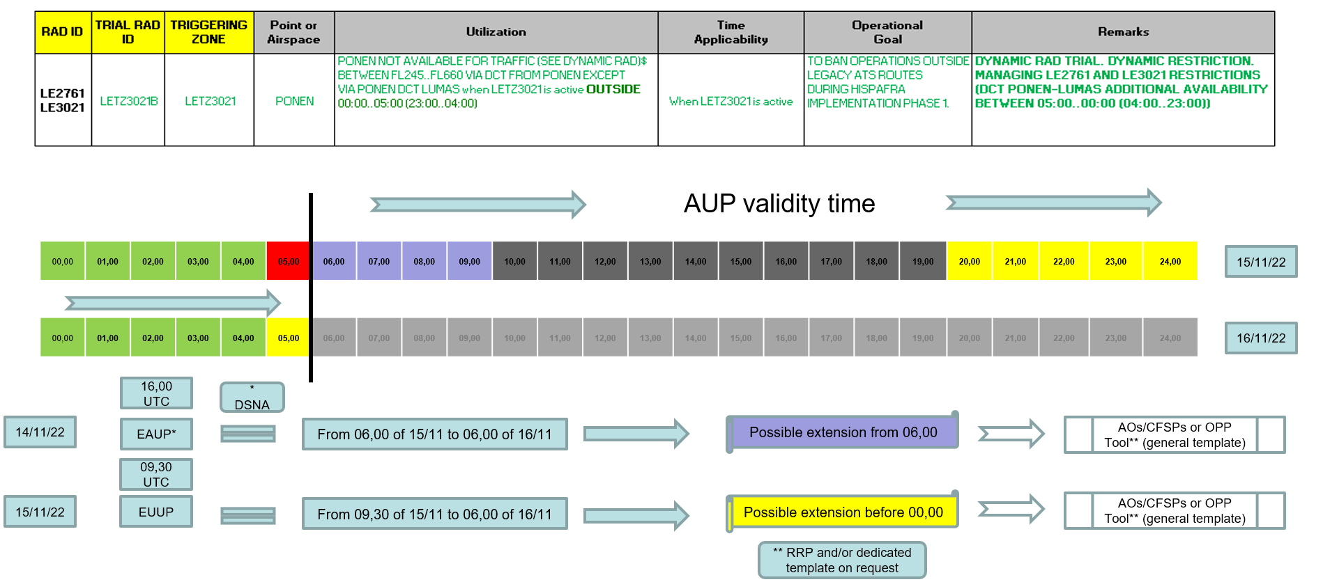
DRAD example and AUP execution timeline

Slide 10
GRRT support
NM GRRT tool will be executed to support DRAD trial.
Initial GRRT execution schedule be aligned to reflect AUP and morning UUP publication to identify possible flights that could benefit from the relaxation.
DRAD proposals will be identified by the Rerouting NOTE in the bottom of the OPLOG HI_REROUTE record (e.g. DRAD - ENAIRE BARDI DCT DELOG [from OPS_DRAD_ENAIRE1.SCENARIO])
AOs are invited to contact NM FE Task Force nm.fetaskforce@ops.cfmu.eurocontrol.int for GRRT related questions and template customization

Slide 11
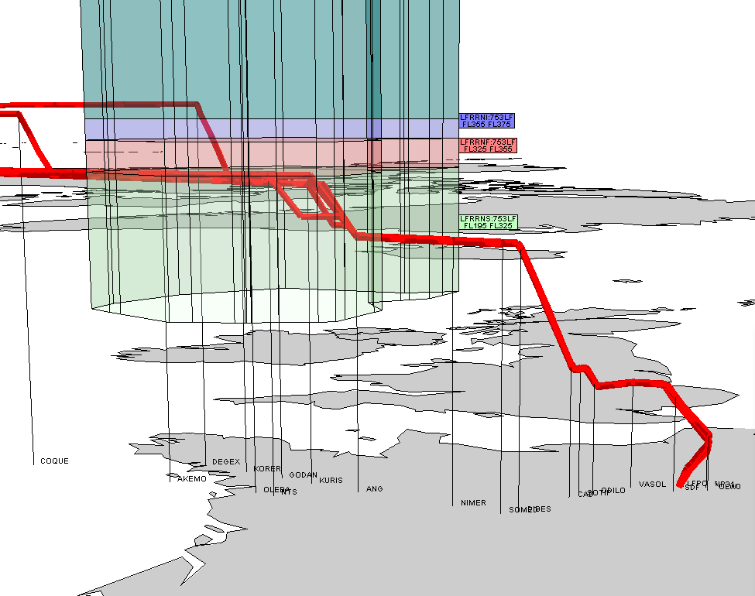
Example of new DRAD (DSNA) – 1st December 2022
LFRRNIU (above FL 355) – new / dynamic
LFRRFIU (above FL 325) – summer 2022
LF2107

Slide 12
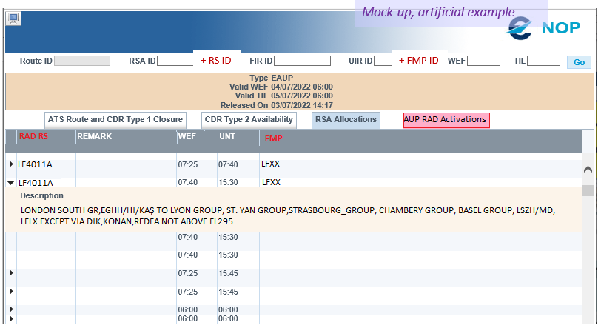
Dynamic RAD evolution – EAUP After NM Version 27.0 an extra tab will be available highlighting the available Dynamic Rad options in an extra tab. It will be used for OPS when the CFSPs/AOs and local ASM tools will complete the migration to the new functionalities.
NM 27.0

